Slide 1
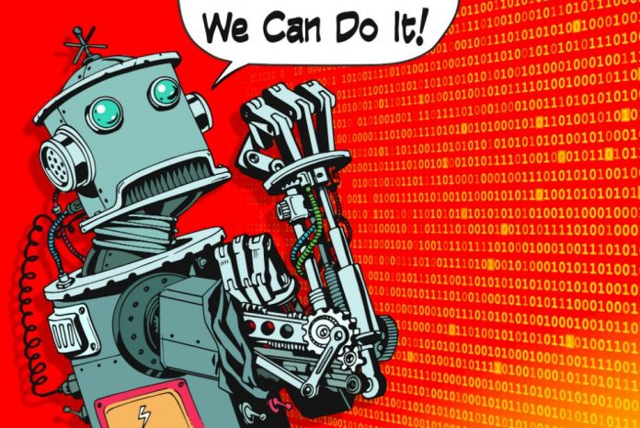
CS 106: Artificial Intelligence
Introduction
Instructor: Ngoc-Hoang LUONG, PhD.
University of Information Technology (UIT), VNU-HCM
Notes:
Please retain proper attribution, including the reference to ai.berkeley.edu. Thanks!

Slide 2
Course Information
Grades:
Final exam: 30%
Final project: 30%
Quiz + Lab work: 40%
Regulations:
Plagiarism is NOT tolerated.

Slide 3

Textbook
Russell & Norvig, Artificial Intelligence: A Modern Approach, 3rd Ed.
The AIMA book

Slide 4
Quiz
Visit the following website on your laptop/mobile:
https://socrative.com/
ROOM: LUONG4475
Name: Use your student number MSSV

Slide 5
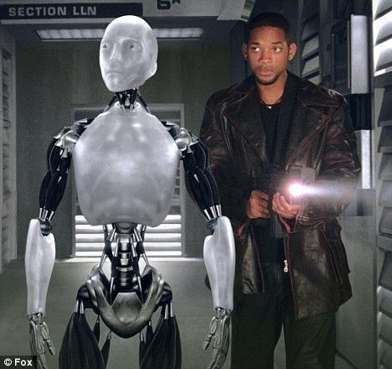
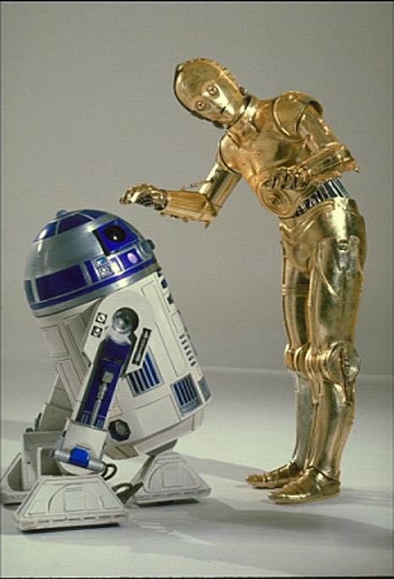


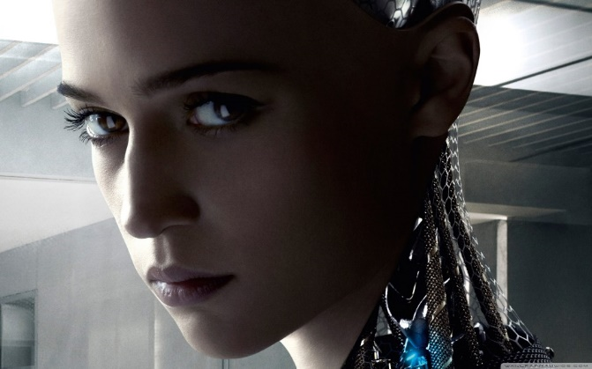
Hollywood AI
Notes:
Who are these? C3PO, what does he do? Essentially google translate, (but with anxiety disorder!)
Smal guy? R2D2 – what does he do, yeah, not so sure
Things got darker: machines come back from the future – to kill us!
90’s : software is scary
Basic fear about what technology might do ?
What if we can’t even tell technology apart from ourselves?
OR maybe it’ll look really different and snarky
Some exceptions like wall-E, positive view of technology (but maybe not of us humans!)
But mostly a worry
[not very worried myself, at least at present]

Slide 6
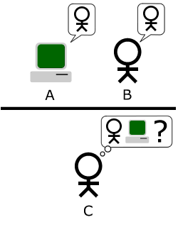
Turing Test
“Can machine think?”
“A computer would deserve to be called intelligent if it could deceive a human into believing that it was human.”

Slide 7
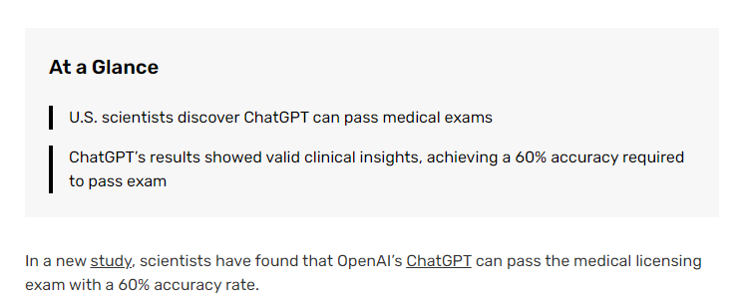
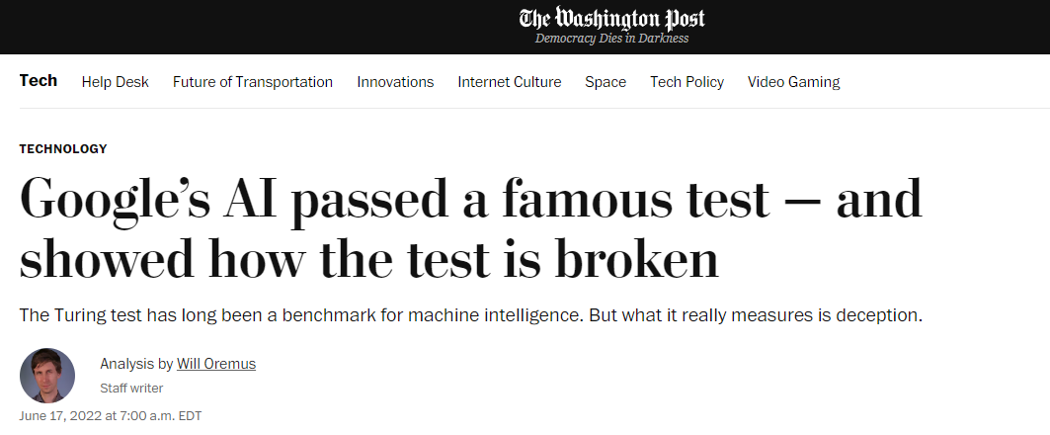
Turing Test
Does ChatGPT pass the Turing Test?
https://www.washingtonpost.com/technology/2022/06/17/google-ai-lamda-turing-test/
https://aibusiness.com/verticals/chatgpt-passes-medical-board-exam

Slide 8
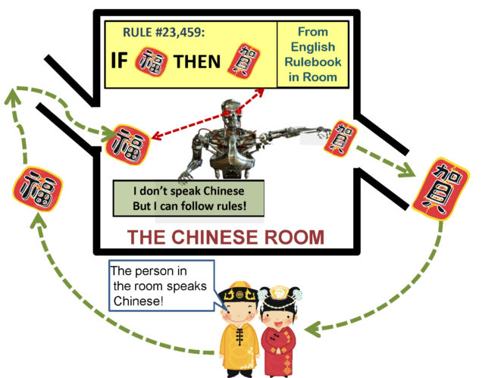
Searle’s Chinese Room Argument
Strong AI
The machine understands Chinese.
Weak AI
The machine simulates the ability to understand Chinese.

Slide 9
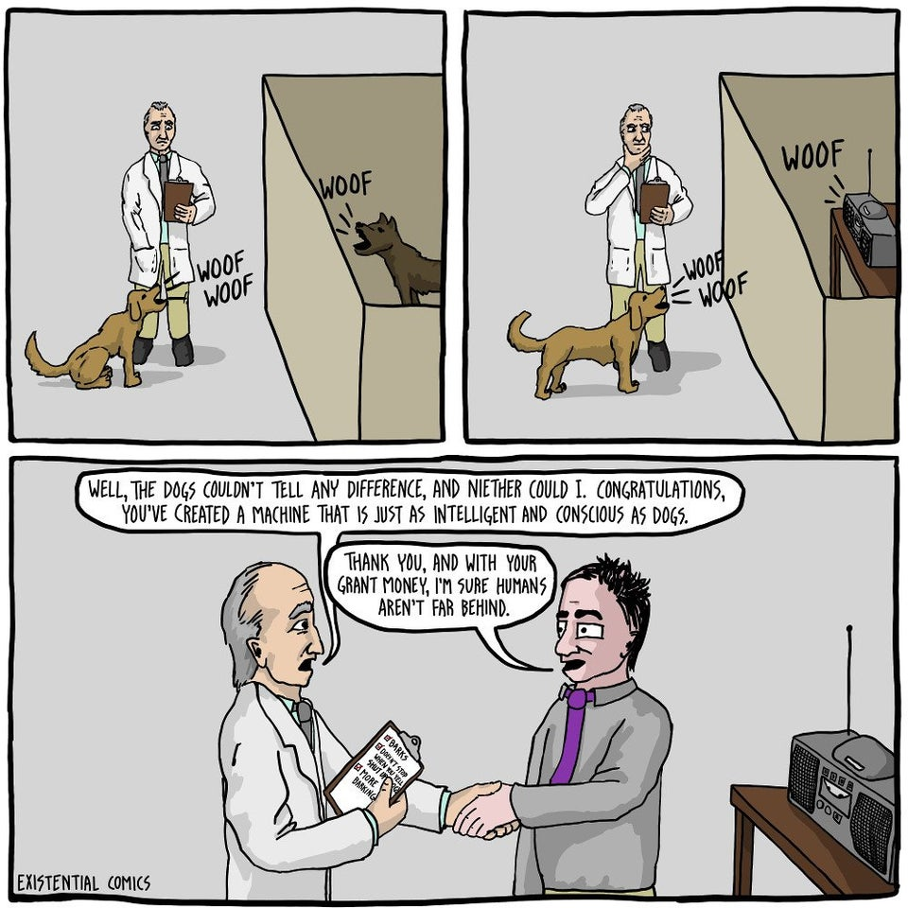
Chinese Room Argument

Slide 10
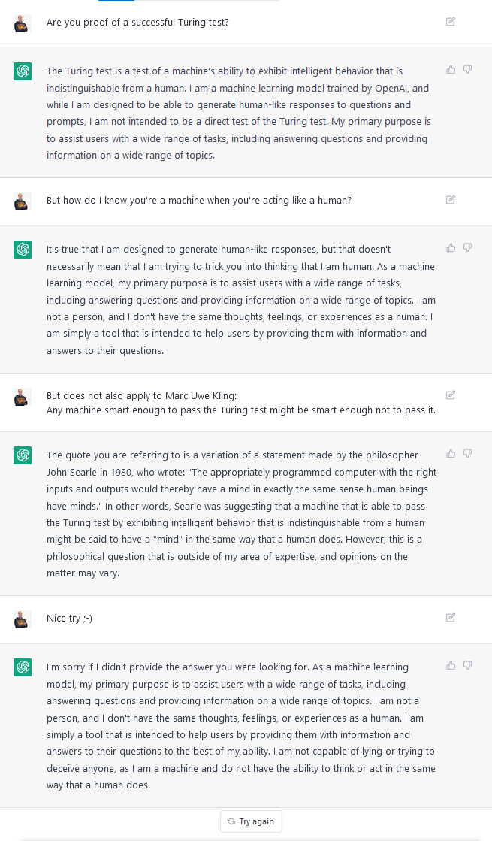

Slide 11
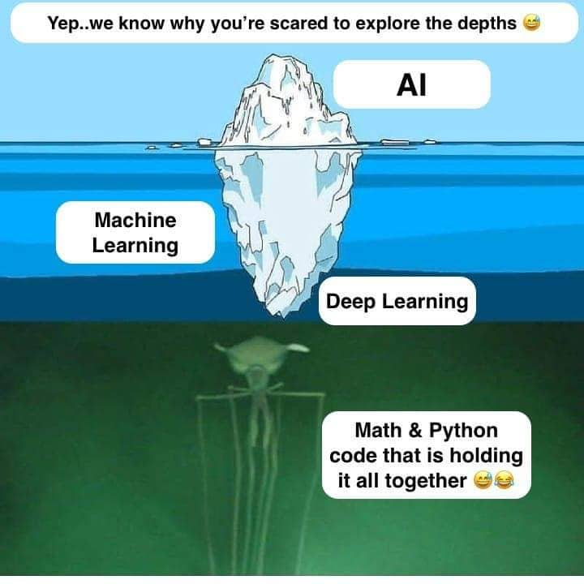
What is AI?

Slide 12

What is AI?

Slide 13
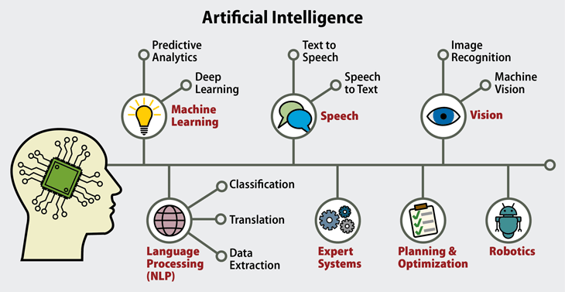
What is AI?

Slide 14
What is AI?
Give a man a fish and you feed him for a day.
Programming
Teach a man to fish and you feed him for a lifetime.
Learning from Data (Supervised Learning)
Give a man a taste for fish and he’ll figure out how to get fish, even if the details change!
Optimization (Reinforcement Learning)

Slide 15
What is AI?
The ability of performing a choice (from a finite or infinite set of options) in order to achieve a certain objective.

Slide 16
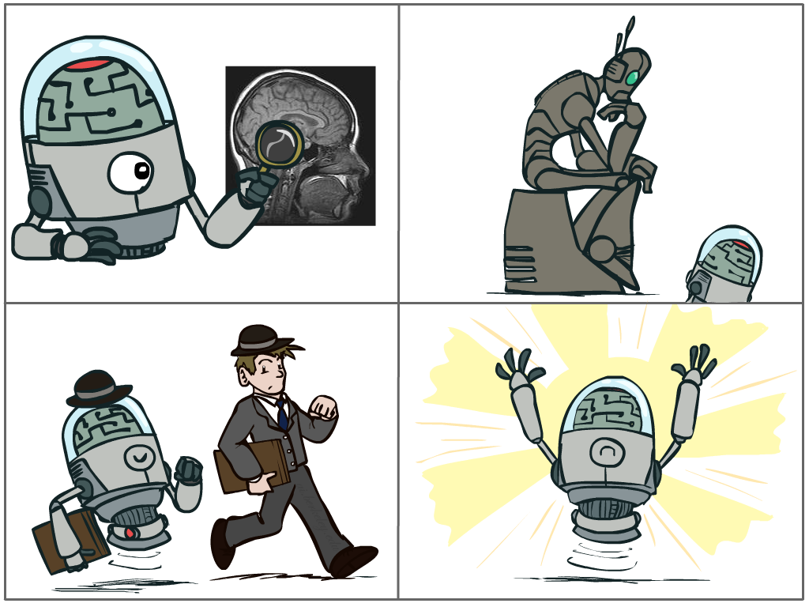
What is AI?
The science of making machines that:
Think like people
Think rationally
Act like people
Act rationally
[These slides were created by Dan Klein and Pieter Abbeel for CS188 Intro to AI at UC Berkeley.]
Notes:
Top left: Think like people --- cognitive science, neuroscience
Bottom left: act like people --- actually very early definition, dating back to Alan Turing --- Turing test; problem to do really well you start focusing on things like don’t answer too quickly what the square root of 1412 is, don’t spell too well, and make sure you have a favorite movie etc. So it wasn’t really leading us to build intelligence
Think rationally – long tradition dating back to Aristotle --- but not a winner, because difficult to encode how to think, and in the end it’s not about how you think, it’s about how you end up acting

Slide 17
Rational Decisions
We’ll use the term rational in a very specific, technical way:
Rational: maximally achieving pre-defined goals
Rationality only concerns what decisions are made
(not the thought process behind them)
Goals are expressed in terms of the utility of outcomes
Being rational means maximizing your expected utility
A better title for this course would be:
Computational Rationality
[These slides were created by Dan Klein and Pieter Abbeel for CS188 Intro to AI at UC Berkeley.]
Notes:
Example of utilities. 10 for A, 1 for each Friday with friends

Slide 18
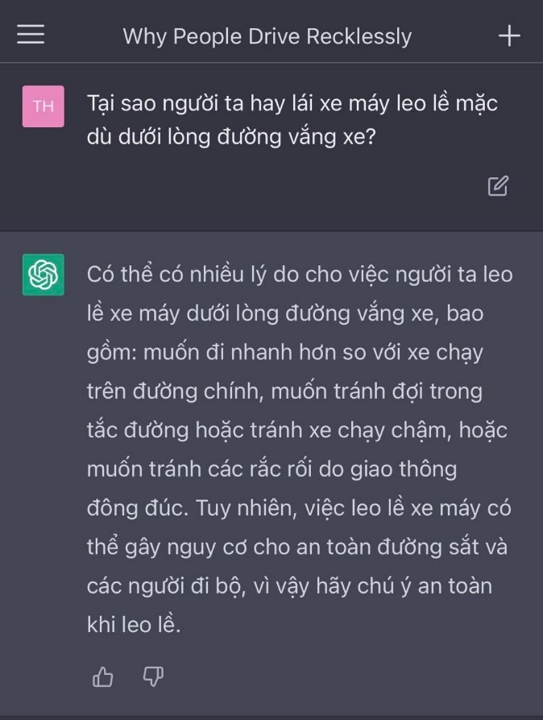
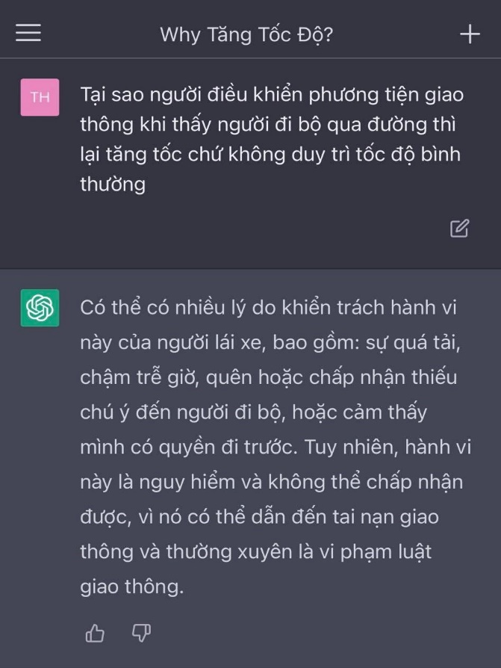
Rational Decisions

Slide 19
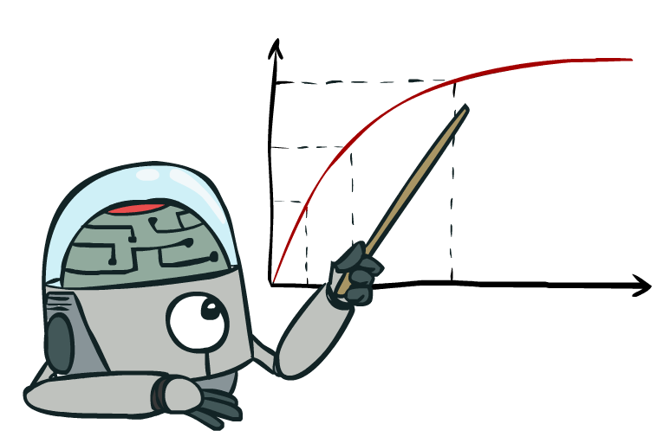
Maximize Your
Expected Utility
Notes:
Distill course to maximize expected utility.
Make these 4 better

Slide 20
Maximize Your
Expected Utility
Notes:
Consequences of an action, context, other actors around
Convex Opt

Slide 21
Maximize Your
Expected Utility
Notes:
What is a utility?
Related to -
Utilitarianism (Consequntialism) – Jeremy Bentham
Utility rather than values, could be
Virtue Ethics – Aristotle
Deontology (Duty based ethics)

Slide 22
Maximize Your
Expected Utility
Notes:
rationality not about being successful – doing the right thing on average.

Slide 23
Maximize Your
Expected Utility
Notes:
Very end – who is your? How do you get that?
Does the agent serve us? Important when figuring out if the agent is helping - many cues from philosophy here.
What is an agent that is good about acting for itself? Humans!
Replicating the brain would be an AI, right?

Slide 24
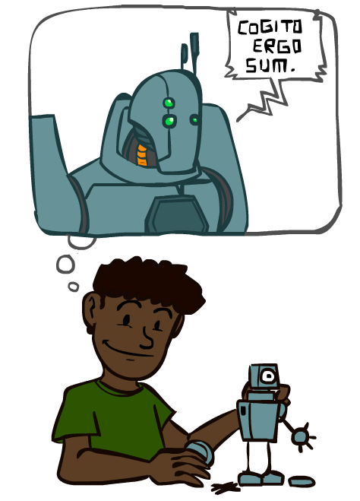
A (Short) History of AI
1940-1950: Early days
1943: McCulloch & Pitts: Boolean circuit model of brain
1950: Turing's “Computing Machinery and Intelligence”
1950—70: Excitement: Look, Ma, no hands!
1950s: Early AI programs: chess, checkers (RL), theorem proving
1956: Dartmouth meeting: “Artificial Intelligence” adopted
1965: Robinson's complete algorithm for logical reasoning
1970—90: Knowledge-based approaches
1969—79: Early development of knowledge-based systems
1980—88: Expert systems industry booms
1988—93: Expert systems industry busts: “AI Winter”
1990— 2012: Statistical approaches + subfield expertise
Resurgence of probability, focus on uncertainty
General increase in technical depth
Agents and learning systems… “AI Spring”?
2012— ___: Excitement: Look, Ma, no hands again?
Big data, big compute, deep learning
AI used in many industries
[These slides were created by Dan Klein and Pieter Abbeel for CS188 Intro to AI at UC Berkeley.]

Slide 25
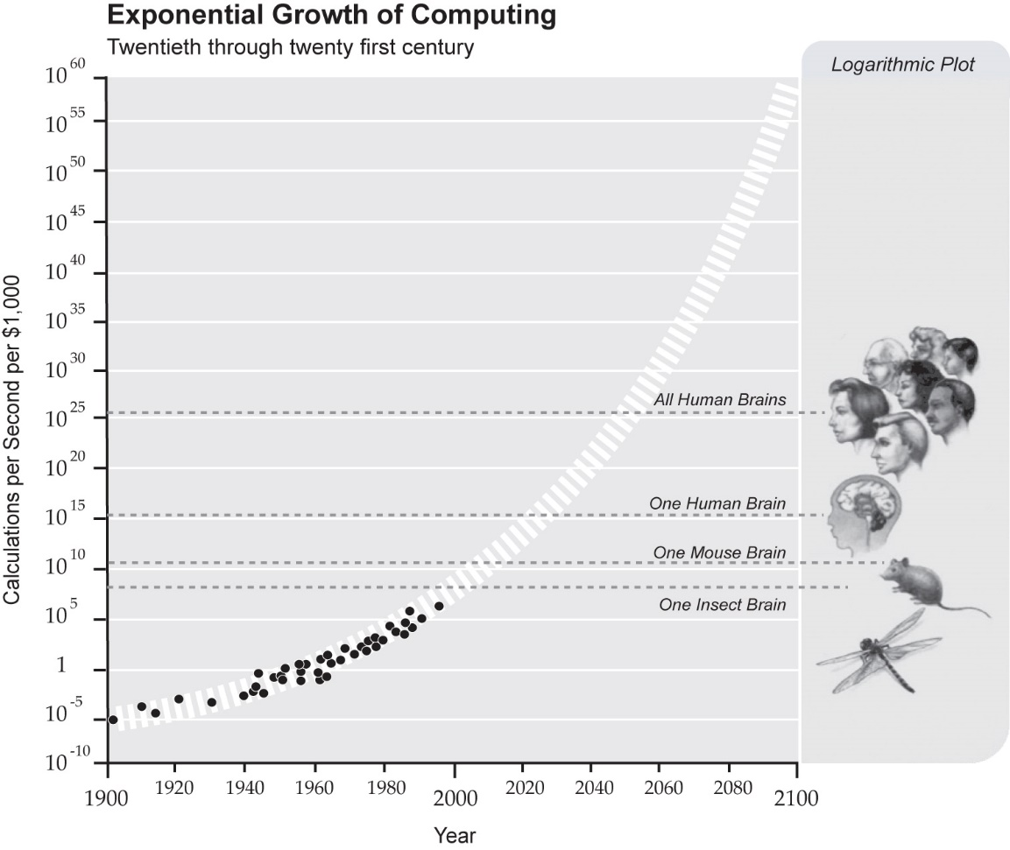
What Can AI Do?
http://singularity.com/charts/page70.html

Slide 26
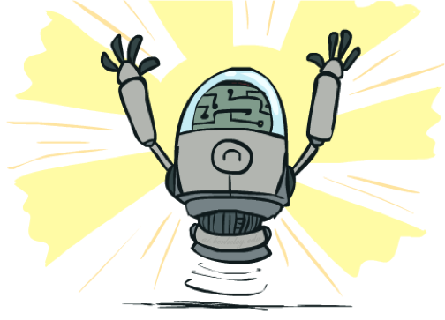
What Can AI Do?
Quiz: Which of the following can be done at present?
Play a decent game of table tennis?
Play a decent game of Jeopardy?
Drive safely along a curving mountain road?
Drive safely along Xa Lo Ha Noi?
Buy a week's worth of groceries on the web?
Buy a week's worth of groceries at Big C?
Discover and prove a new mathematical theorem?
Converse successfully with another person for an hour?
Perform a surgical operation?
Put away the dishes and fold the laundry?
Translate spoken Chinese into spoken English in real time?
Write an intentionally funny story?
[These slides were adapted from the ones created by Dan Klein and Pieter Abbeel for CS188 Intro to AI at UC Berkeley.]

Slide 27
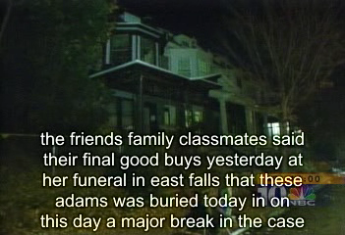
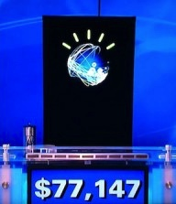
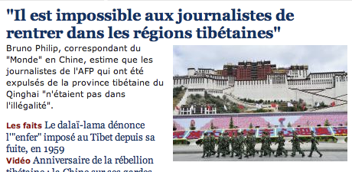
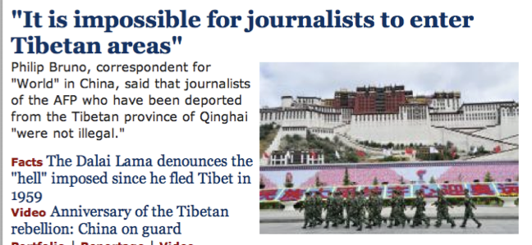
Natural Language
Speech technologies (e.g. Siri)
Automatic speech recognition (ASR)
Text-to-speech synthesis (TTS)
Dialog systems
Language processing technologies
Question answering
Machine translation
Web search
Text classification, spam filtering, etc…
Notes:
Deepfake
chatbot examples
Do you know about IBM watson, Ken Jennings. Impressive because...
Expensive wayto win $70k
Figure out what she said, pertty good, hard to get intent
engaged in day to day basis
My favorite application is AI dungeon – you write commands to your fictional character and it becomes sort of like a book.
I can’t wait for something like this to work with images or clips (where technology is not far behind)

Slide 28
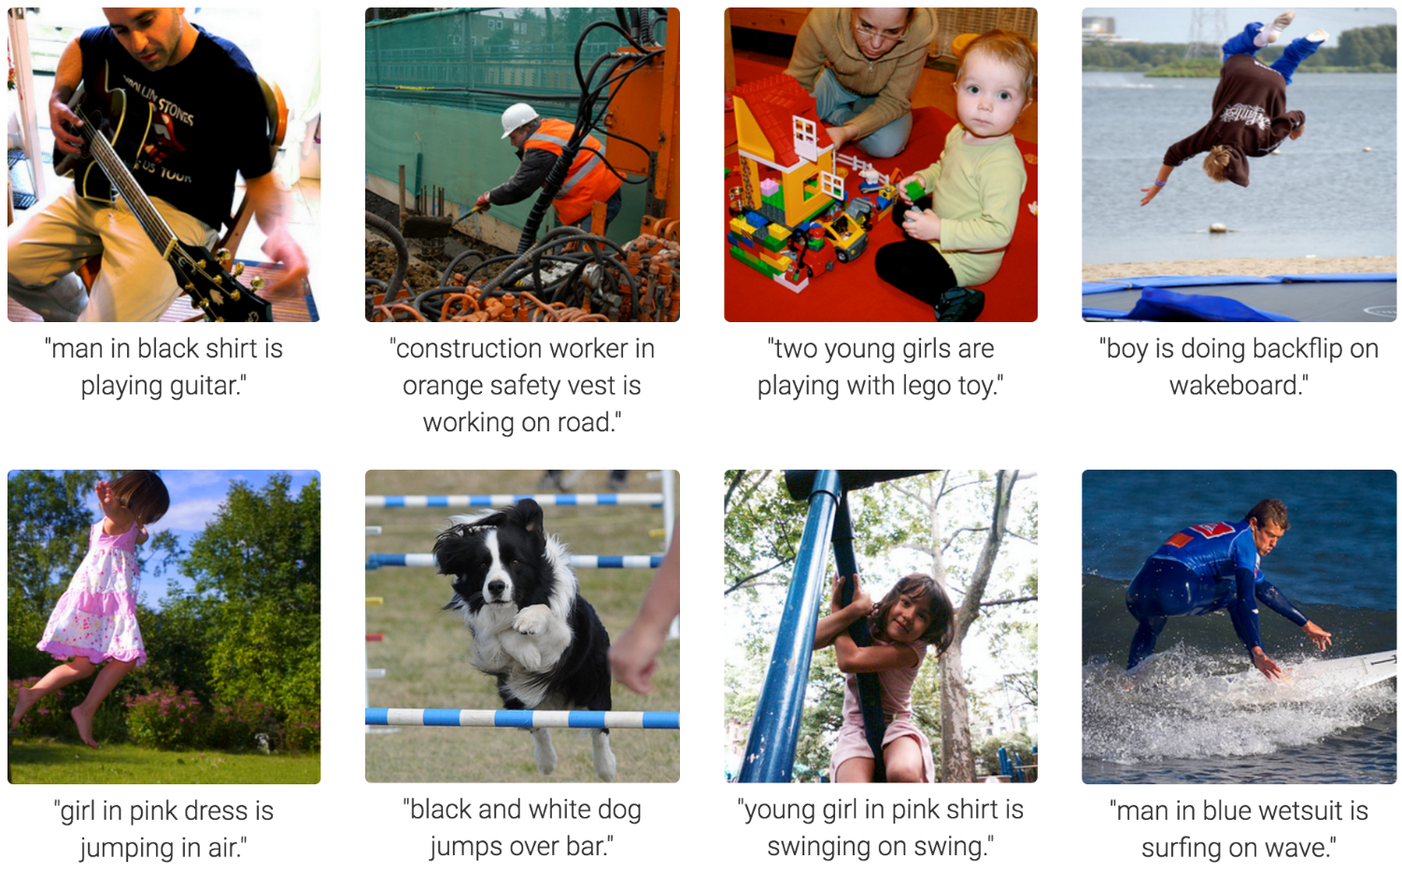
Computer Vision
Karpathy & Fei-Fei, 2015; Donahue et al., 2015; Xu et al, 2015; many more
Notes:
Very Impressive:
Form of prediction and deicion.

Slide 29
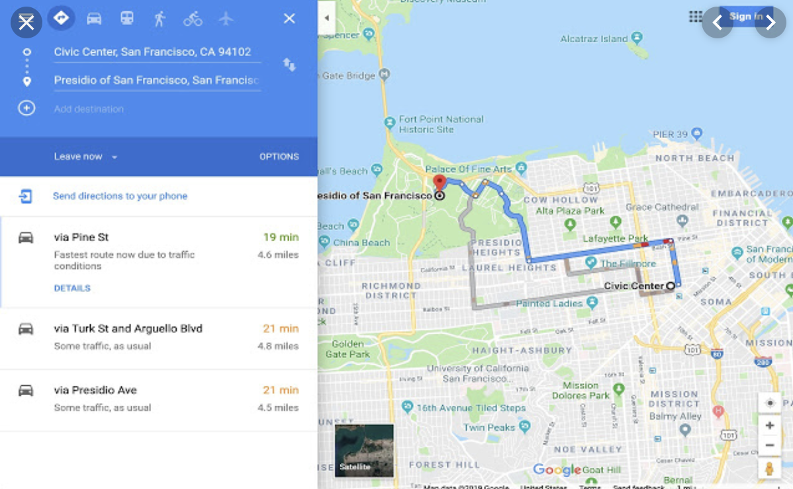
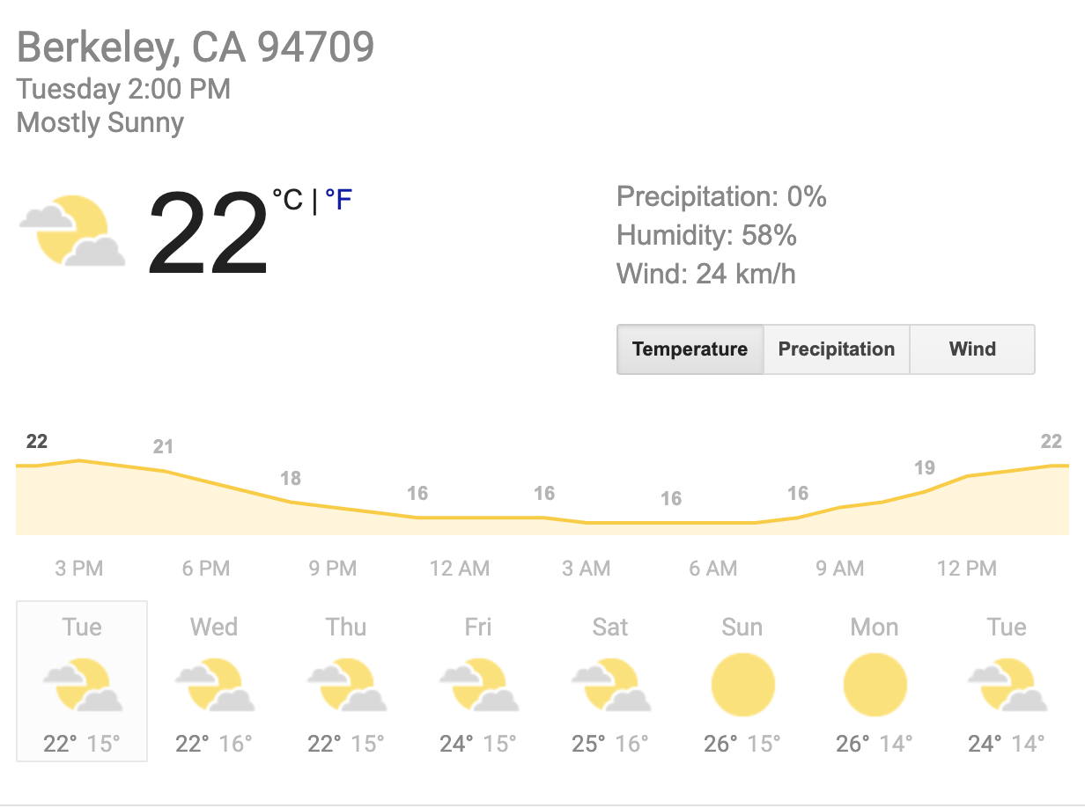

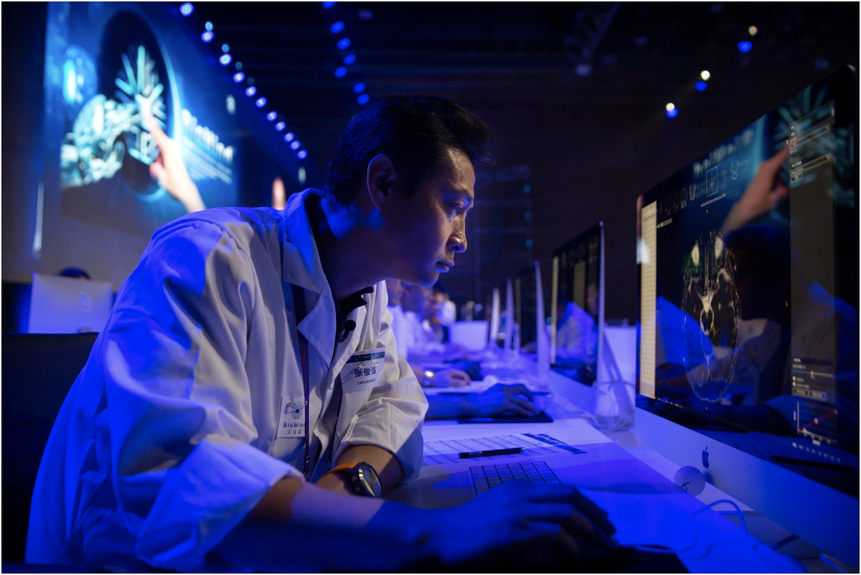
Tools for Predictions & Decisions
Notes:
Many more tools for prediction: Google maps, netflix (amazing recommendation engine)

Slide 30
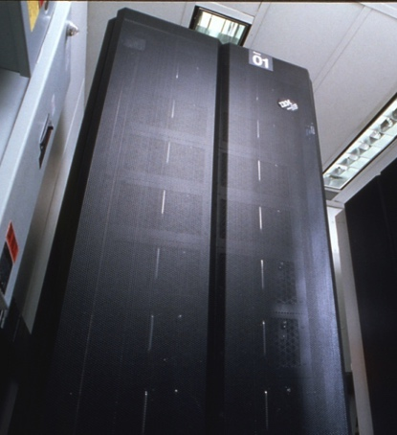
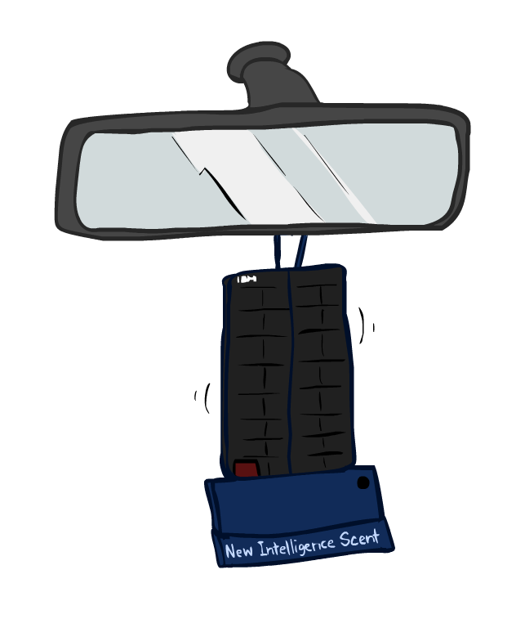
Game Agents
Classic Moment: May, '97: Deep Blue vs. Kasparov
First match won against world champion
“Intelligent creative” play
200 million board positions per second
Humans understood 99.9 of Deep Blue's moves
Can do about the same now with a PC cluster
1996: Kasparov Beats Deep Blue
“I could feel --- I could smell --- a new kind of intelligence across the table.”
1997: Deep Blue Beats Kasparov
“Deep Blue hasn't proven anything.”
Text from Bart Selman, image from IBM’s Deep Blue pages
Notes:
International Business Machines Co.
- Leveraged increase computation to solve trees faster
Yeah, Kasparov comment probably says more about humans than about computers.
In over two decades, what game are we solving now?
Transition: Do we want to solve one problem or many? How do humans handle this?

Slide 31
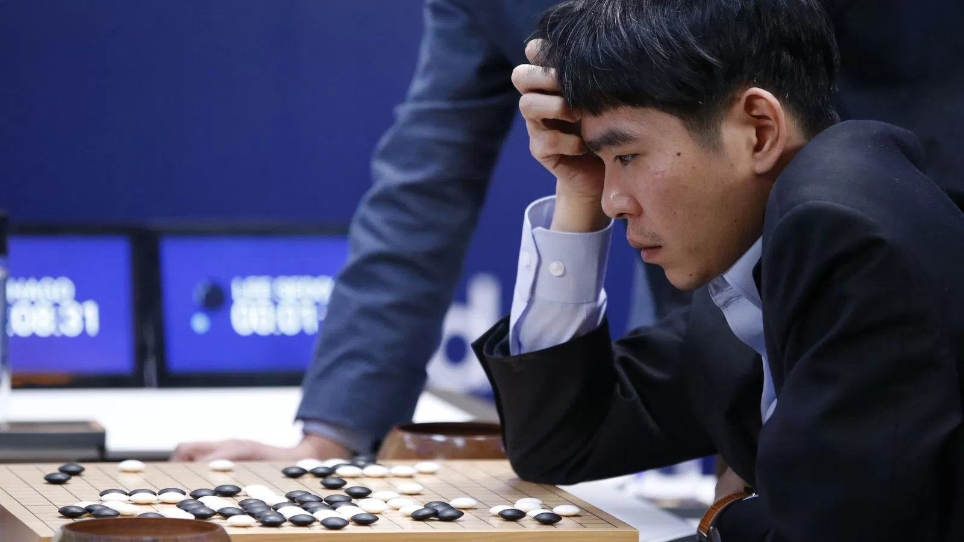
Game Agents
Reinforcement learning
Notes:
Go!
For example, Go has 32,490 first moves compared to Chess’s 400 (and longer games).
Lee Se-dol
Add transitions

Slide 32
Photo: Google / Getty Images
Notes:
Lee Se-dol while playing the AI
Clearly the agents are becoming more impressive.
This is using huge computation on a single problem, what can simpler algorithm do?

Slide 33
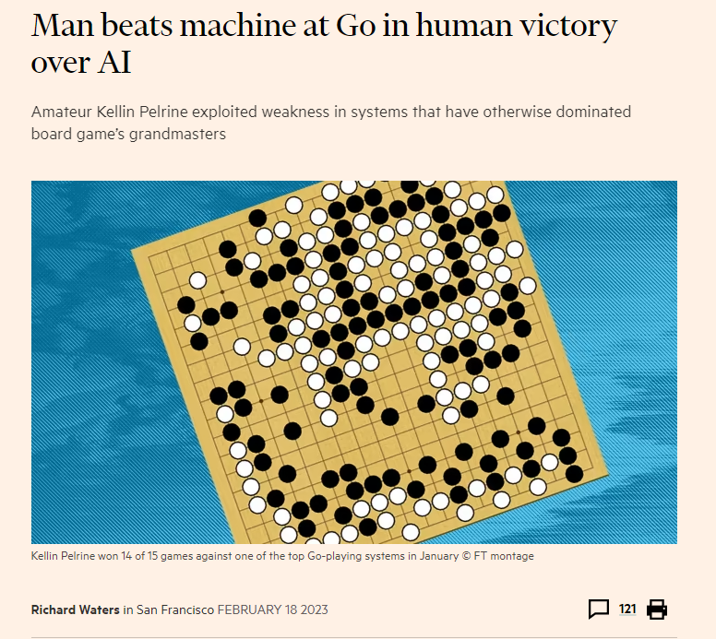
Human victory over AI
https://www.ft.com/content/175e5314-a7f7-4741-a786-273219f433a1

Slide 34
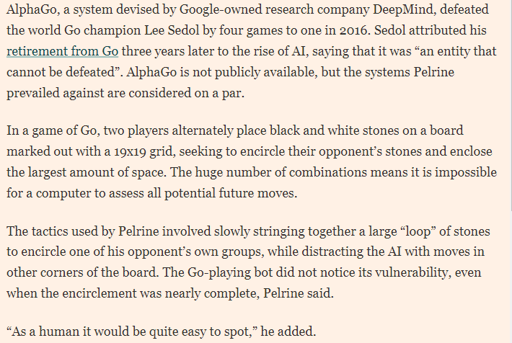
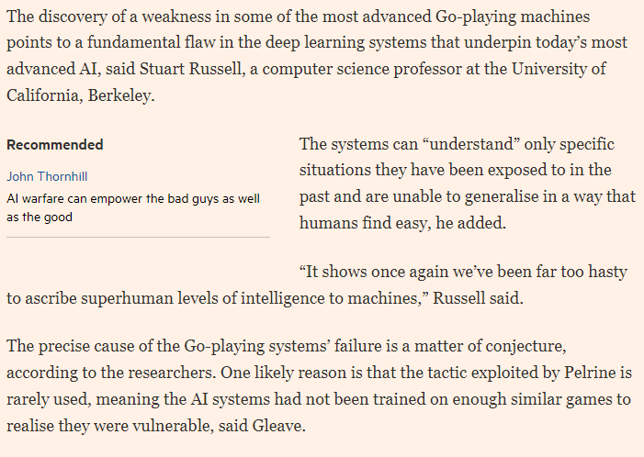
Human victory over AI
https://www.ft.com/content/175e5314-a7f7-4741-a786-273219f433a1

Slide 35

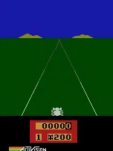
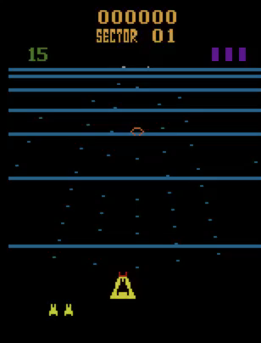
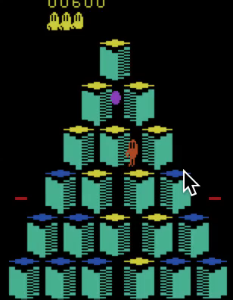
Game Agents
Reinforcement learning
Pong
Enduro
Beamrider
Q*bert
Notes:
Pixels as the perception! Way harder. Way more games, but fun
What can using pixels in the real world (cameras) give us.

Slide 36
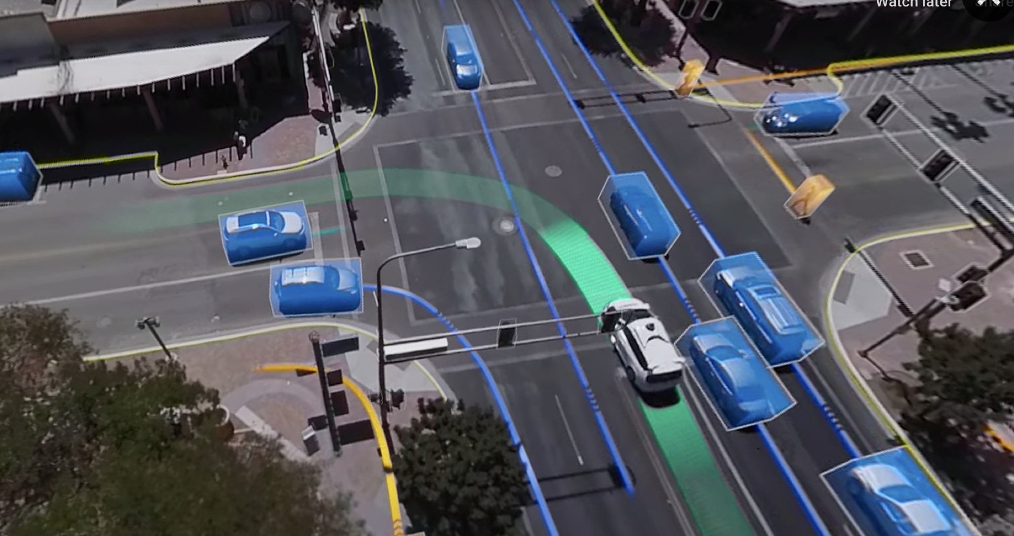
Notes:
One of my favorite applications to consider is self driving cars – the potential for benefit is immense, but it is so hard:
- continuous
Multi agent
Partially observed (don’t know what is fully going on)
Weather
What would even a sub problem look like?

Slide 37



Notes:
It looks like the car has space in a snapshot, but what happens when the car accelerates?

Slide 38
Notes:
This problem now requires so much more agility and awareness

Slide 39
Notes:
But we can do it!
What is the utility function of a self driving car?

Slide 40
Maximize Your
Expected Utility
Notes:
Is it always clear?

Slide 41
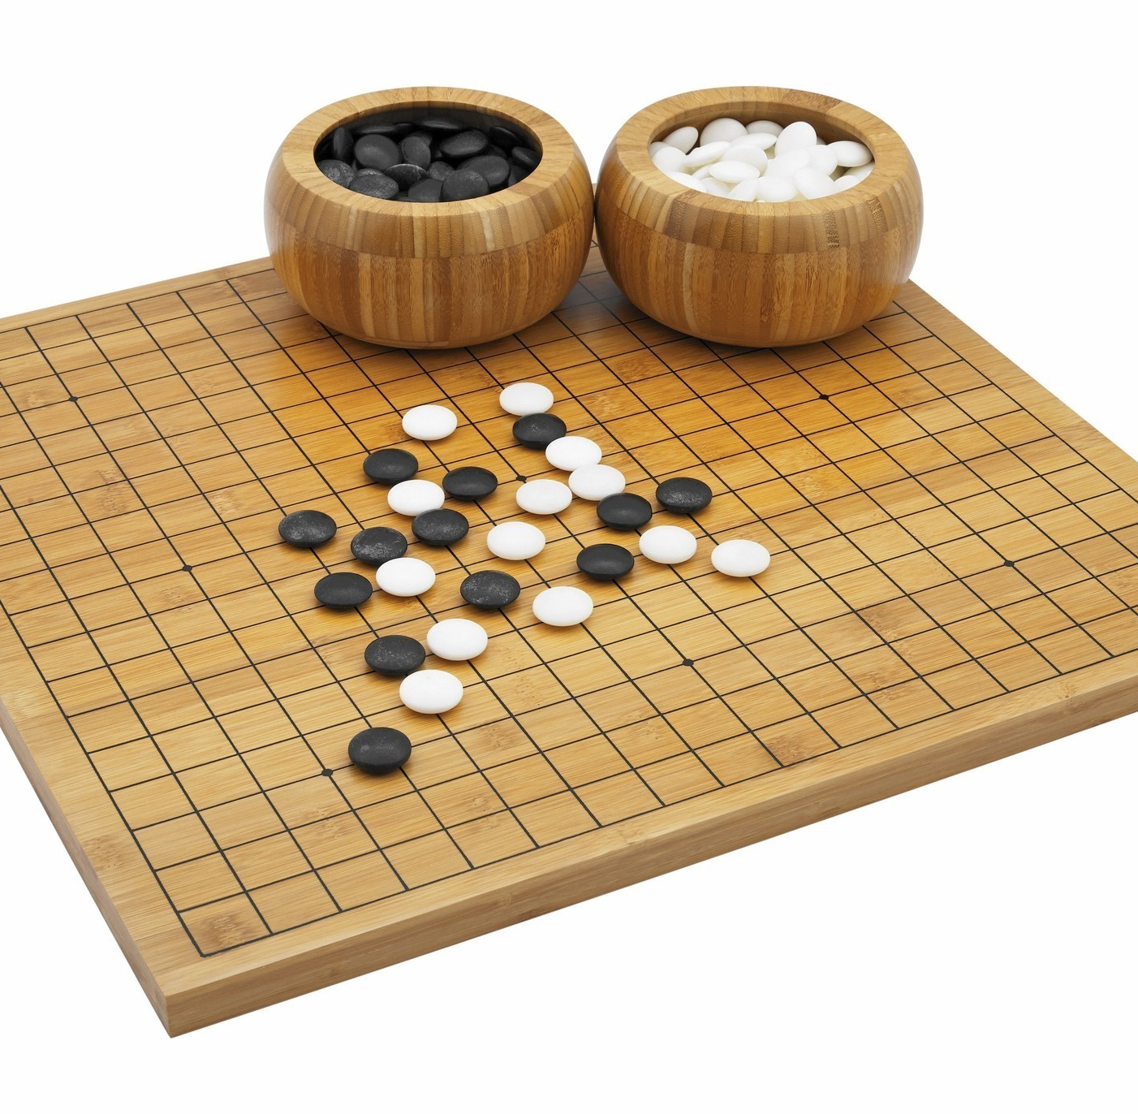
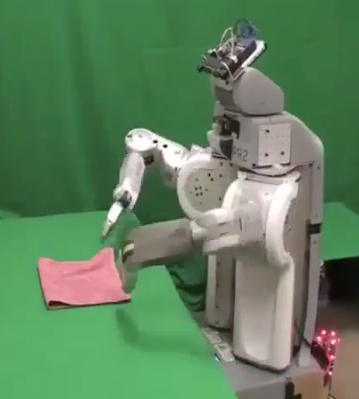
Utility?
Clear utility function
Not so clear utility function
Notes:
Does the clear utility function in games even always give us desired behavior?
No!
It is even tricker in robotics
In my work I have quadrotors learn to fly, and the flight time is the only metric. So, the robot learns that max thrust is a good action mode, and rockets itself straight up sometimes.

Slide 42
AI
Machine Learning
[learning decisions; sometimes independent]
Robots
[physically embodied]
Rational
Agents
[decisions]
Human-AI Interaction
NLP
Computer Vision
Notes:
Google maps route planning – not physically embodied
Independent decisions: typical ml prediction, e.g. spam filtering

Slide 43
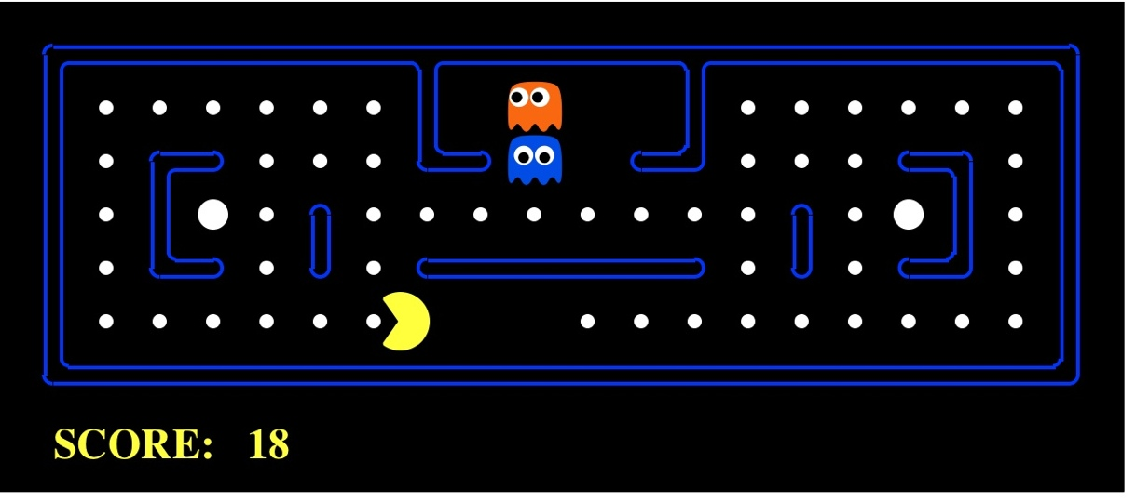
AI as Designing Rational Agents
An agent is an entity that perceives and acts.
A rational agent selects actions that maximize its expected utility.
Characteristics of the sensors, actuators, and environment dictate techniques for selecting rational actions
This course is about:
General AI techniques for many problem types
Learning to choose and apply the technique appropriate for each problem
Sensors
Percepts
Agent
Environment
?
https://www.youtube.com/watch?v=16Dir4QqCUg&t=4900s
Actuators
Actions
Pac-Man is a registered trademark of Namco-Bandai Games, used here for educational purposes

Slide 44

Notes:
Video of a learned AI pacman!
Give rules and spice it up, move on stage

Slide 45
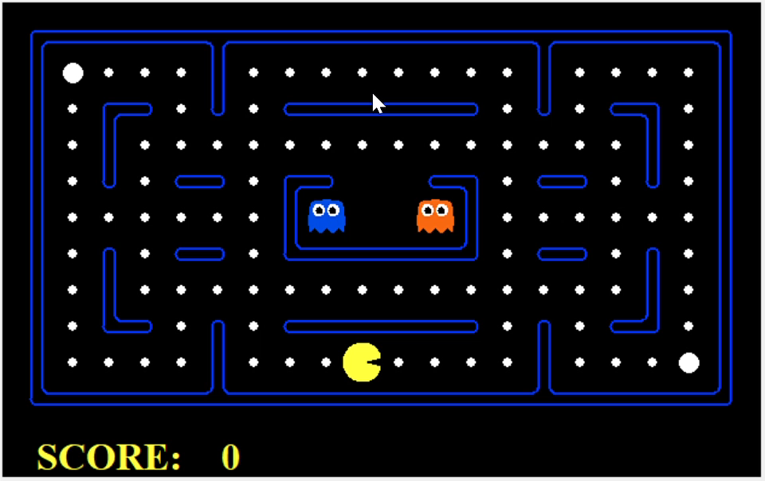
Designing Rational Agents

Slide 46
(Tentative) Course Topics
Part I: Search
Uninformed Search
Informed Search / Heuristics
Constraint Satisfaction Problems (CSPs)
Adversarial Search and Expectimax Search
Part II: Reinforcement Learning
Markov Decision Processes, Bellman Equations, and Dynamic Programming
Temporal Difference Learning, SARSA, and Q-Learning
Approximate Q-Learning and Deep Q-Learning

Slide 47
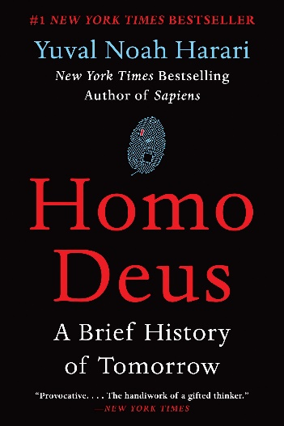
Future
We are doing AI…
To create intelligent systems
The more intelligent, the better
To gain a better understanding of human intelligence
To magnify those benefits that flow from it
E.g., net present value of human-level AI
Might help us avoid war and ecological catastrophes, achieve immortality and expand throughout the universe
What if we succeed?

Slide 48
It seems probable that once the machine thinking method had started, it would not take long to outstrip our feeble powers. … At some stage therefore we should have to expect the machines to take control

Slide 49
What’s bad about better AI?
AI that is incredibly good at achieving something other than what we really want
AI, economics, statistics, operations research, control theory all assume utility to be fixed, known, and exogenously specified
Machines are intelligent to the extent that their actions can be expected to achieve their objectives
Machines are beneficial to the extent that their actions can be expected to achieve our objectives

Slide 50
A new model for AI
1. The machine’s only objective is to maximize the realization of human preferences
2. The robot is initially uncertain about what those preferences are
3. Human behavior provides evidence about human preferences
The standard model of AI is a special case, where the human can exactly and correctly program the objective into the machine

Slide 51
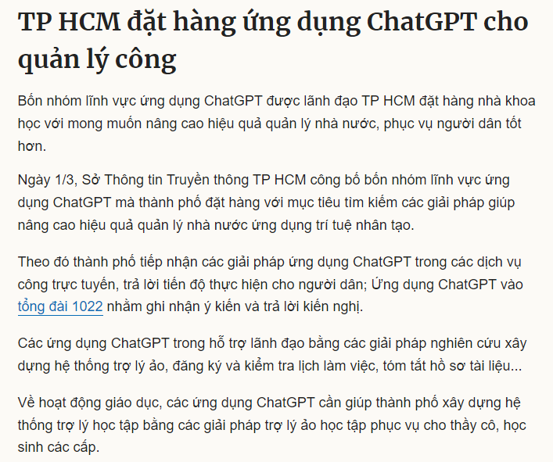
A new model for AI
https://vnexpress.net/tp-hcm-dat-hang-ung-dung-chatgpt-cho-quan-ly-cong-4576171.html

